Slide 1

Implementation of certificate authority(CA) in python
CZ4010 Team HC

Slide 2

Digital certificate
Electronic "password" to exchange data securely over the Internet
Public key infrastructure (PKI).
Also known as:
public key certificate
identity certificate.

Slide 3

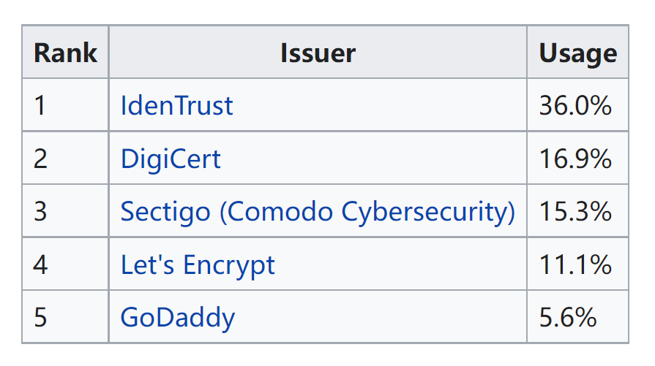
Certificate Authority
Trusted entity
Sign digital certificates

Slide 4
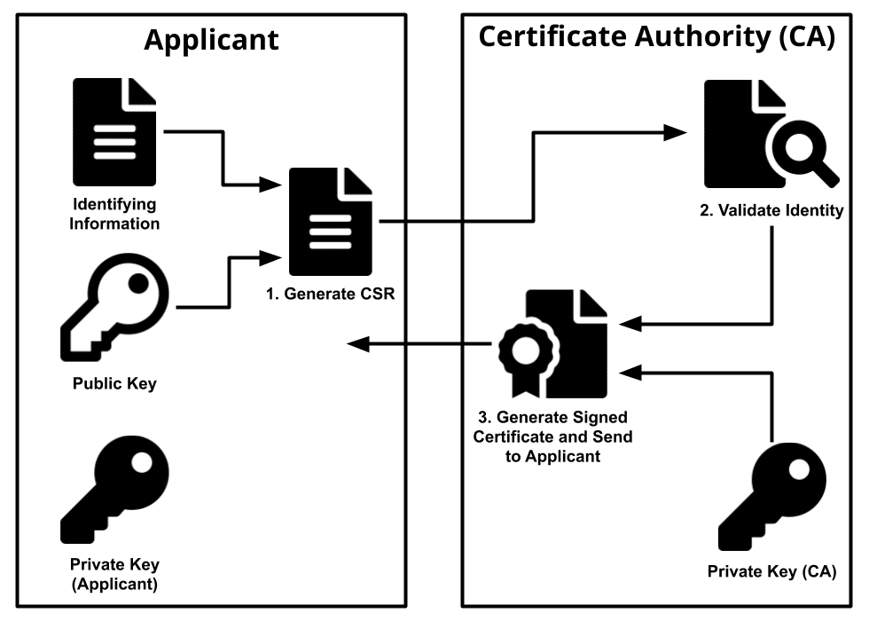
Workflow of CA
1. Generate private and public key pair
(RSA, key-size = 2048, e = 63357)
2. Generate CSR(public key + info)
3. CA validate identity
4. CA sign certificate with its private key
5. Others verify certificate with CA’s signature and CA’s public key.

Slide 5
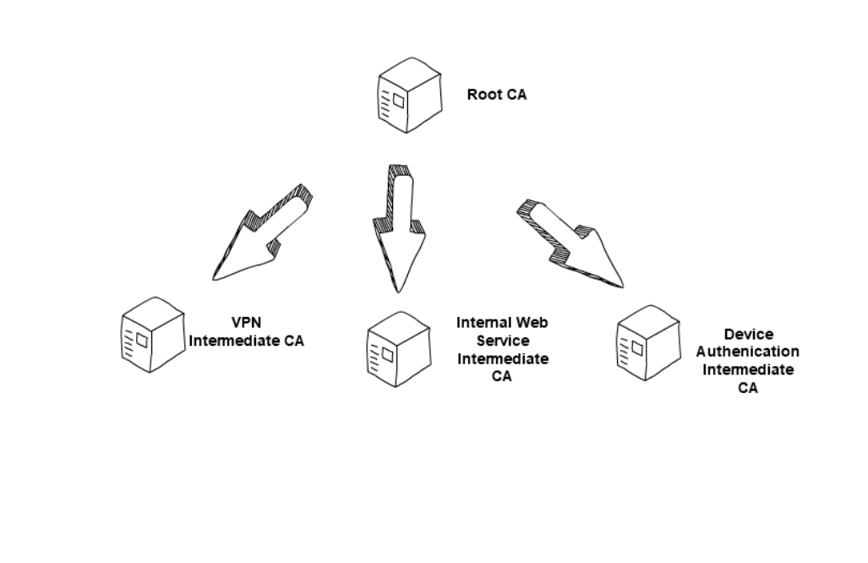
CA Hierarchy
Root CA sign certificate to certify Intermediate Cas
Intermediate CA sign certificate for clients
Advantages:
1. Appropriate level of security to each layer
2. Division of administrative tasks for better load balancing and security
3. Enable different validity period for different level

Slide 6

Be-your-own-CA
Why?
Asking trusted 3rd party to sign can be costly
Especially for demonstrating and testing
But:
Others will not recognize you as a trust-worthy entity!
Cannot be used for commercial purposes
How?
This project demonstrate setting up your own CA in Python!

Slide 7


Project Motivation
There are software available to easily create your own CA
The most commonly used: OpenSSL
Implementation in Python:
Cryptography library based on openSSL
One of the most popular programming languages nowadays
Easy to demonstrate the task without the need of downloading other software
Allows easy integration with other projects

Slide 8
Project Live Demo

